Slide 1

Carrier – Dashboard
1 100 %
2 100 %
3 110 %
4 100 %
5 101 %
For each Carrier a button
Coloring
Percentange generated out of Overall Energy Consumption of the first and last itteration
6 100 %
7 100 %
8 100 %
9 101 %
10 100 %
11 100 %
12 100 %
13 100 %
14 100 %
15 100 %

Slide 2
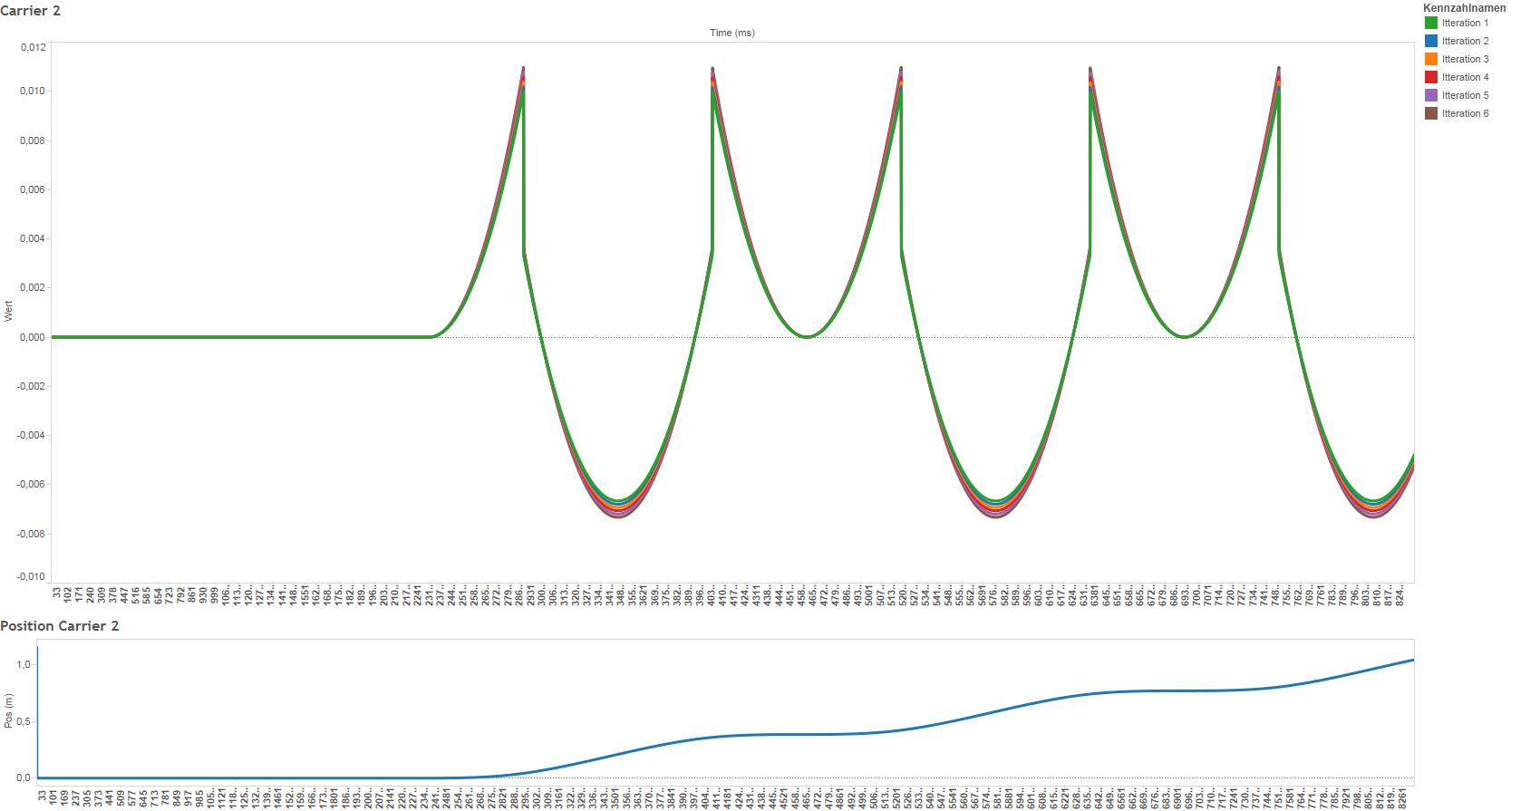
2 Possible Views:
Last x Iterations for a one time contamination
Set of Itterations for a creeping iteration (1 – 25 – 50 – 100 -150 -200)

Slide 3
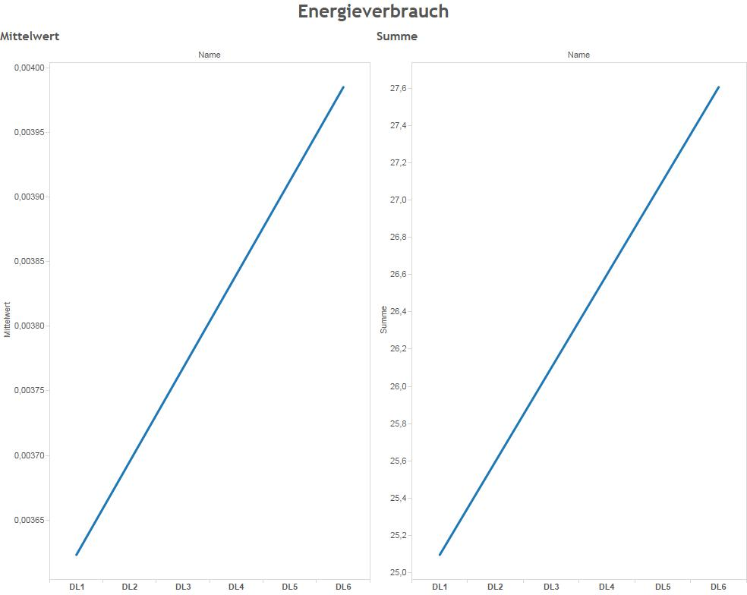
2 Possible Views:
Average Energy Consumption per carrier
Sum of Energy Consumption
Multiple carriers
Multiple sessions

Slide 4
Visualization done by Daniel
Dummy Data done by Rene

